Slide 1



Inside AirBnB data - Quebec
View in Power BI
Last data refresh:
07/02/2020 11:19:57 Mountain Standard Time
Downloaded at:
07/02/2020 11:48:08 Mountain Standard Time

Slide 2
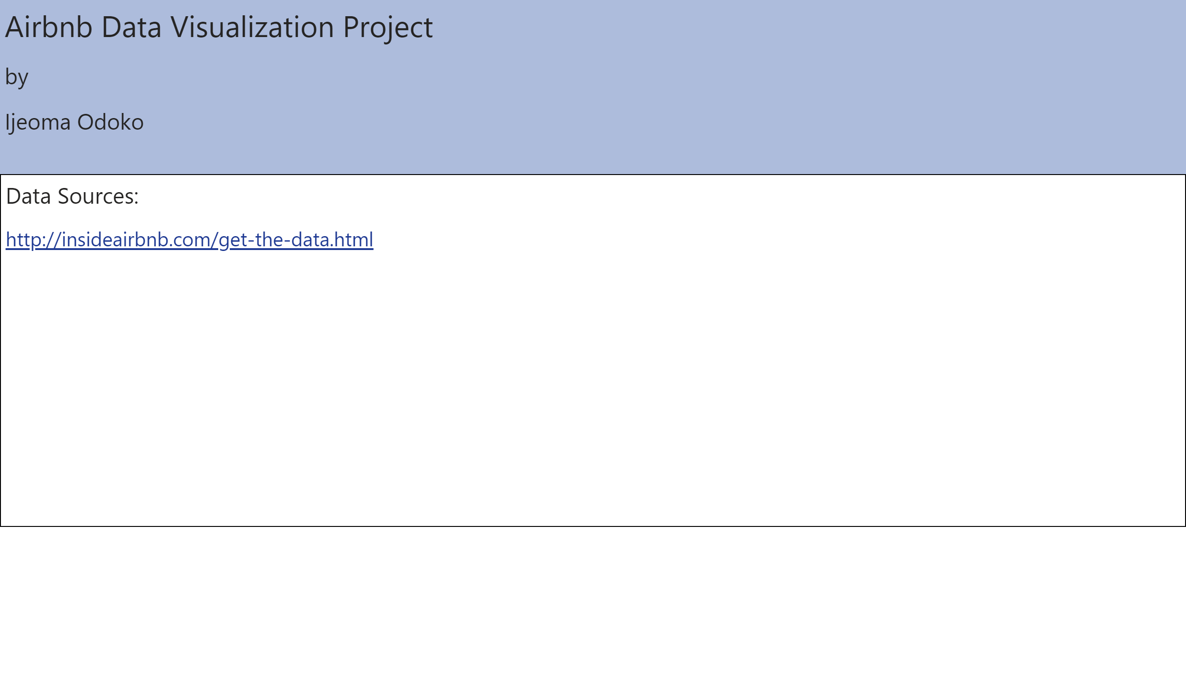

Slide 3
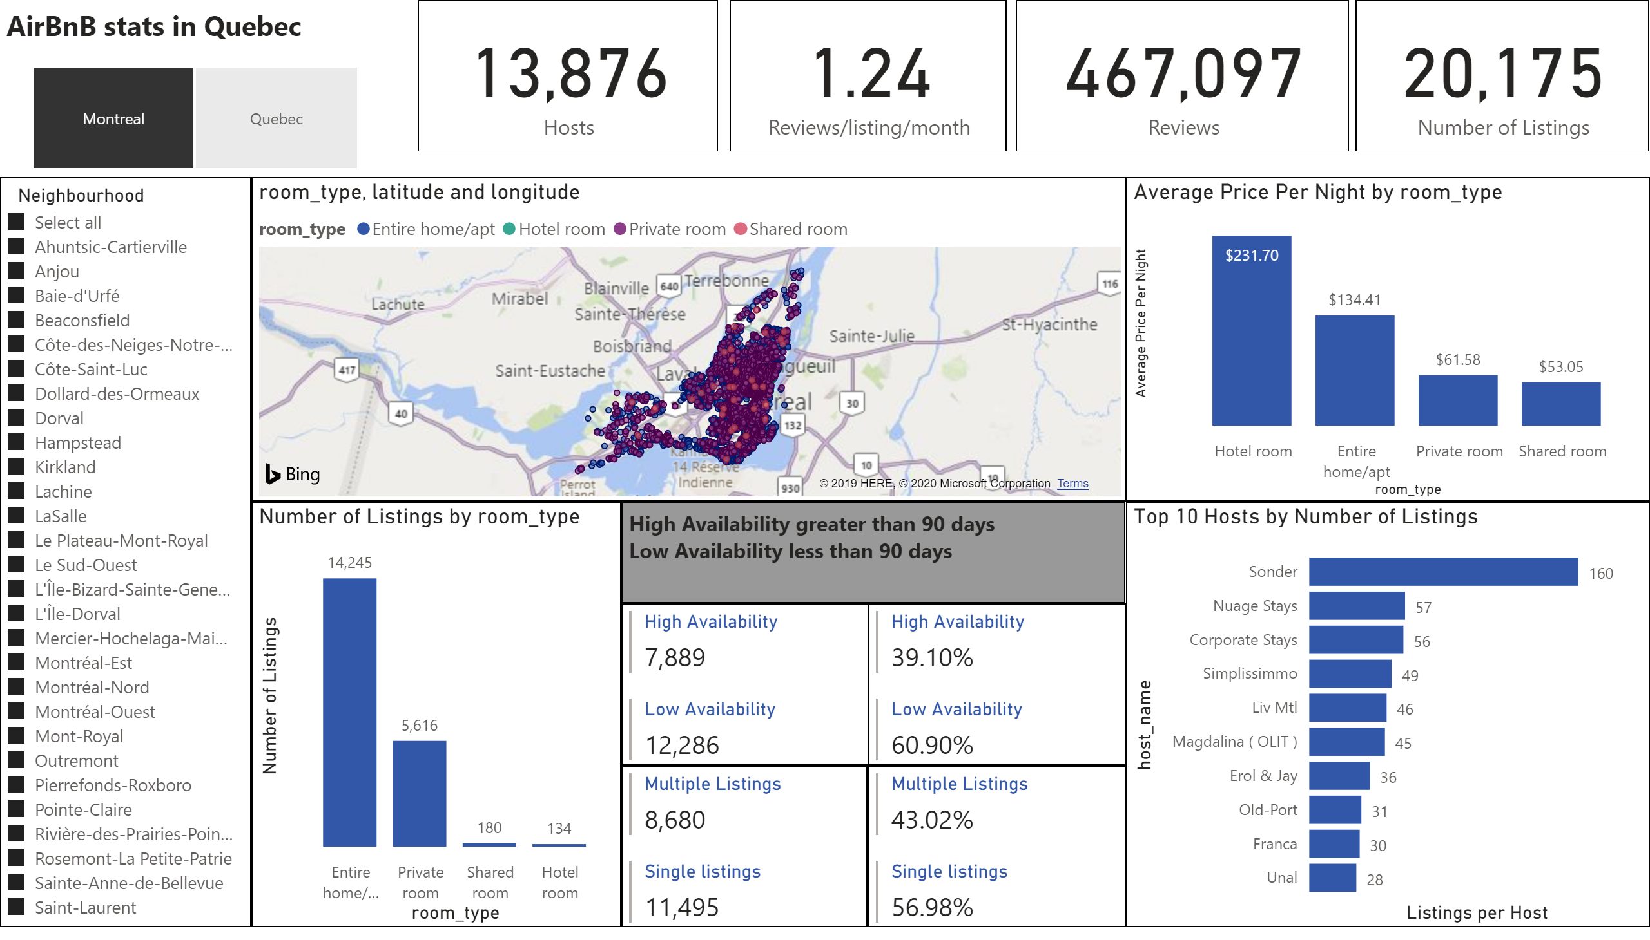

Slide 4
